Slide 1

UNIT 1: Who am I?
Self-check 1

Slide 2
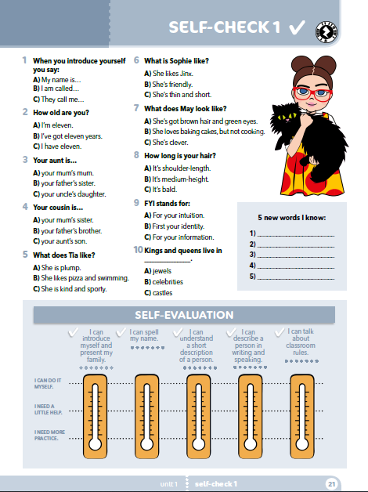
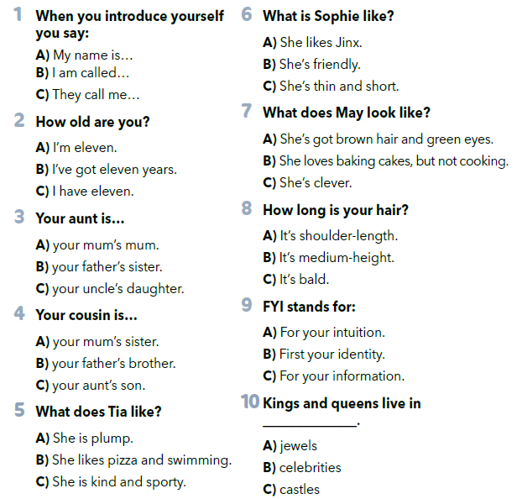
SELF-CHECK 1
Choose the correct answers (a, b or c).

Slide 3
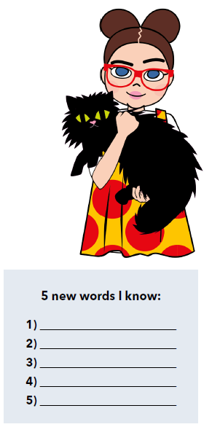

Slide 4
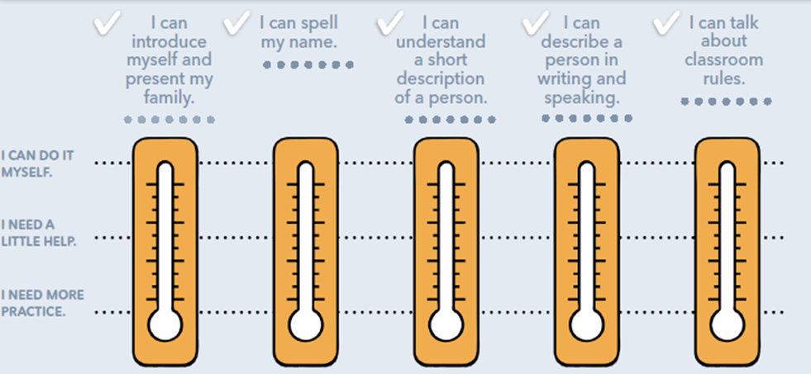
Procijeni vlastito znanje uz listu za samoprocjenu:
Znam predstaviti sebe i svoju obitelj.
Znam usmeno i pisano opisati osobu.
Znam govoriti o razrednim pravilima.
Znam slovkati svoje ime.
Razumijem kratki opis osobe.
Mogu to samostalno učiniti.
Potrebna mi je manja pomoć.
Trebam to dodatno uvježbati.

Slide 5
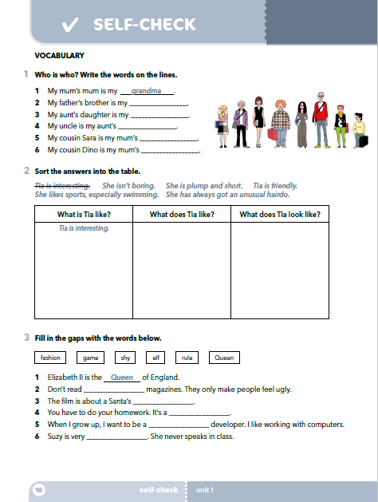
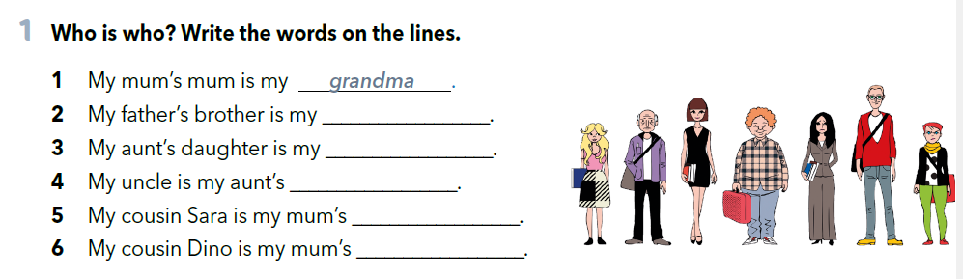
Workbook, page 16.
uncle
cousin
husband
niece
nephew

Slide 6
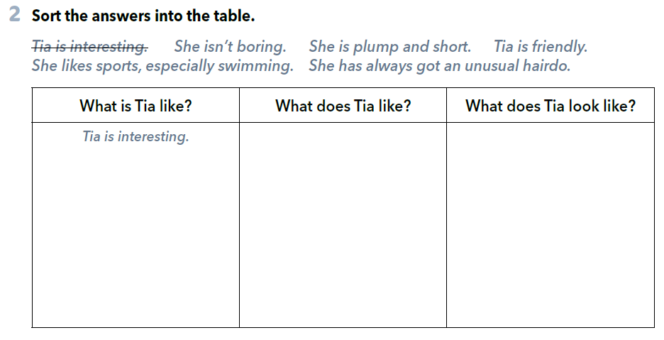
She likes sports, especially swimming.
She is plump and short.
She has always got an unusual hairdo.
She isn’t boring.
Tia is friendly.

Slide 7
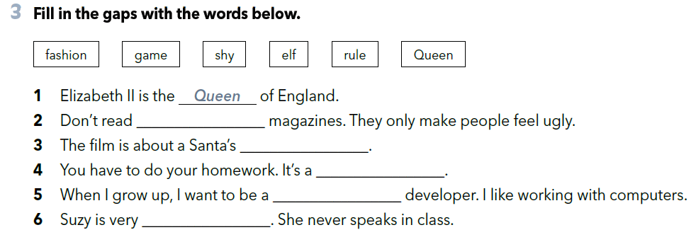
fashion
elf
rule
game
shy

Slide 8
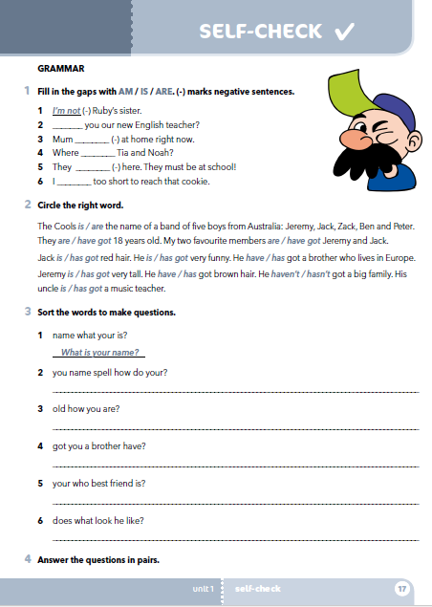
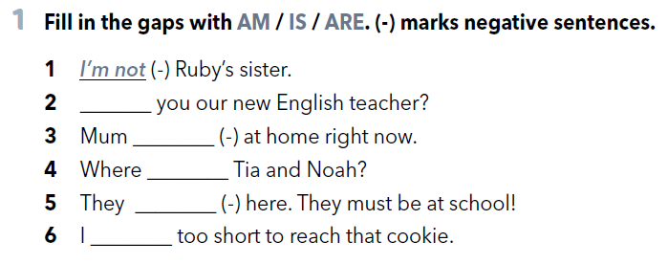
Workbook, page 17.
Are
isn’t
are
aren’t
am

Slide 9
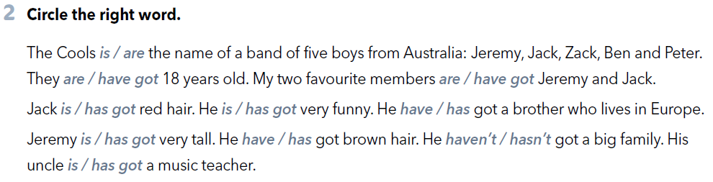

Slide 10
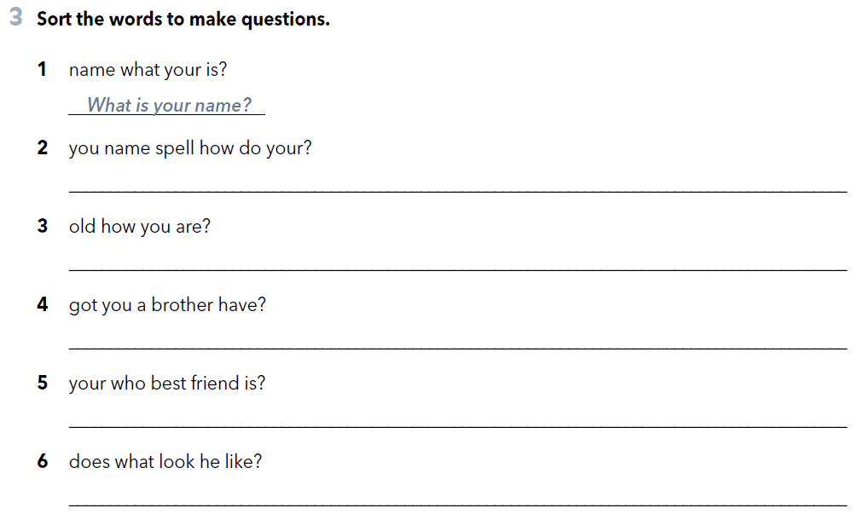
How do you spell your name?
How old are you?
Have you got a brother?
Who is your best friend?
What does he look like?

Slide 11
Click on the link and complete the tasks
(Vocabulary, Grammar).
https://www.e-sfera.hr/dodatni-digitalni-sadrzaji/1e17671b-ae0a-4f15-a3dd-a99a1e50fbca/

